Slide 1

Using Databases for Data Analytics
Notes:
Prompt: Data Scientists coding in SQL to analyze large-scale databases

Slide 2
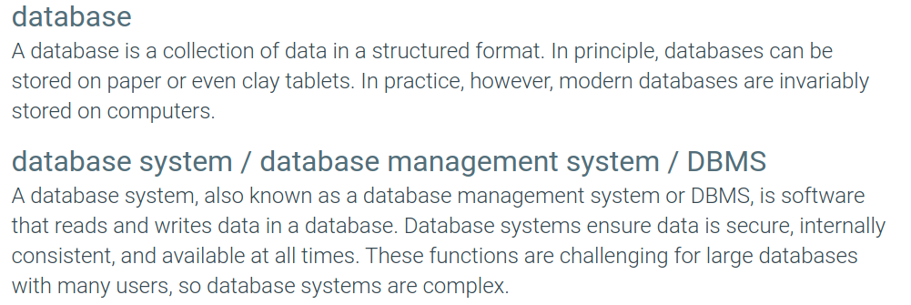
What is a Database?

Slide 3
Can we Access Data without a Database Management System?
Sure, we can! Start by storing the data in flat files on your PC:
students.txt courses.txt professors.txt
Now write programs to implement specific tasks

Slide 4
Doing it without a DBMS...
Enroll “Mary Johnson” in “CS 452”:
Read ‘students.txt’
Read ‘courses.txt’
Find & update the record “Mary Johnson”
Find & update the record “CS 452”
Write “students.txt”
Write “courses.txt”
Write a program to do the following:

Slide 5
Drawbacks of using file systems to store data:
Data redundancy and inconsistency
Multiple file formats, duplication of information in different files
Difficulty accessing data
Need to write a new program to carry out each new task
Concurrent Access by multiple users (How do you assure consistency?)
Integrity problems (What if there is a failure in the middle of an update?)
Integrity constraints (e.g. account balance > 0) become part of program code
Hard to add new constraints or change existing ones

Slide 6
Functionality of a DBMS
The programmer sees :
Data Definition Language – DDL
Create tables
Data Manipulation Language - DML
query language
Behind the scenes the DBMS has:
Query optimizer
Query engine
Storage management
Transaction Management (concurrency, recovery)

Slide 7
Data Definition Language (DDL)
Specification notation for defining the database schema:
create table account ( account-number char(10), balance integer);
DDL compiler generates a set of tables stored in a data dictionary
Data dictionary contains metadata (i.e., data about data)
Database schema
Information about tables, columns, data types, and constraints.
Data storage and definition language
Specifies how data is stored and accessed.
Includes indexing, partitioning, and other performance-related features.

Slide 8
Data Manipulation Language (DML)
Language for accessing and manipulating the data organized by the appropriate data model
DML also known as query language
Two classes of languages
Procedural – user specifies what data is required and how to get those data
Nonprocedural – user specifies what data is required without specifying how to get those data
SQL is the most widely used query language

Slide 9
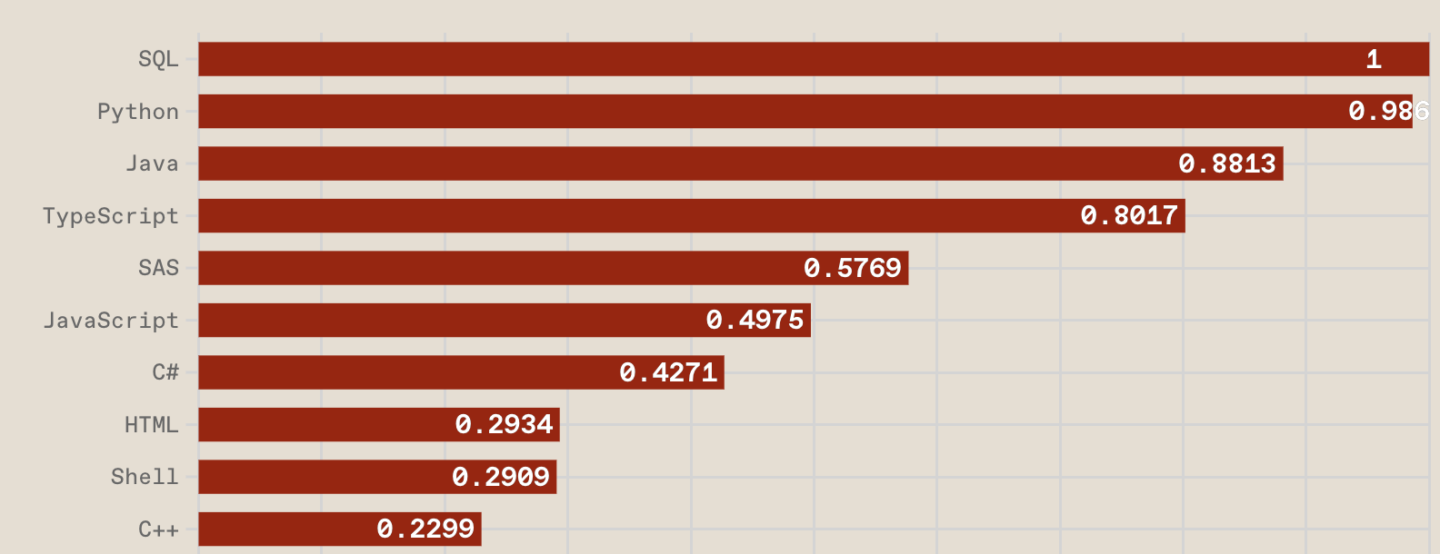
Top Programming Languages 2024 (Based on Job postings)
Stephen Cass, 22 Aug 2024 https://spectrum.ieee.org/top-programming-languages-2024
Notes:
Languages most in demand according to job postings.

Slide 10
Structured Query Language (SQL)
SQL was initially developed at in the early 1970s
Initially called SEQUEL (Structured English Query Language), was designed to manipulate and retrieve data stored in IBM's original database management system
In the late 70's Oracle saw the potential and helped popularize SQL
1979 – Oracle markets the first relational DB with SQL
1986 – ANSI SQL released
1989, 1992, 1999, 2003 – Major ANSI standard updates
SQL 23 is the latest release

Slide 11

The History of SQL Standards
Introduces a variety of enhancements and modern features, such as a JSON data type, also improves recursive query capabilities with CYCLE clauses, and adds an ANY_VALUE aggregate function, which simplifies complex analytical queries.
SQL: 2023
Notes:
The latest version of the ANSI SQL standard is SQL:2023. It introduces a variety of enhancements and modern features, such as a JSON data type, allowing for more efficient handling of JSON data. This version also improves recursive query capabilities with CYCLE clauses, and adds an ANY_VALUE aggregate function, which simplifies complex analytical queries. Additionally, it allows optional length specifications for VARCHAR and CHARACTER VARYING types, offering greater flexibility when defining string columns.

Slide 12







Many Dialects of SQL
(T-SQL)
ClearScape Analytics
PL/SQL

Slide 13
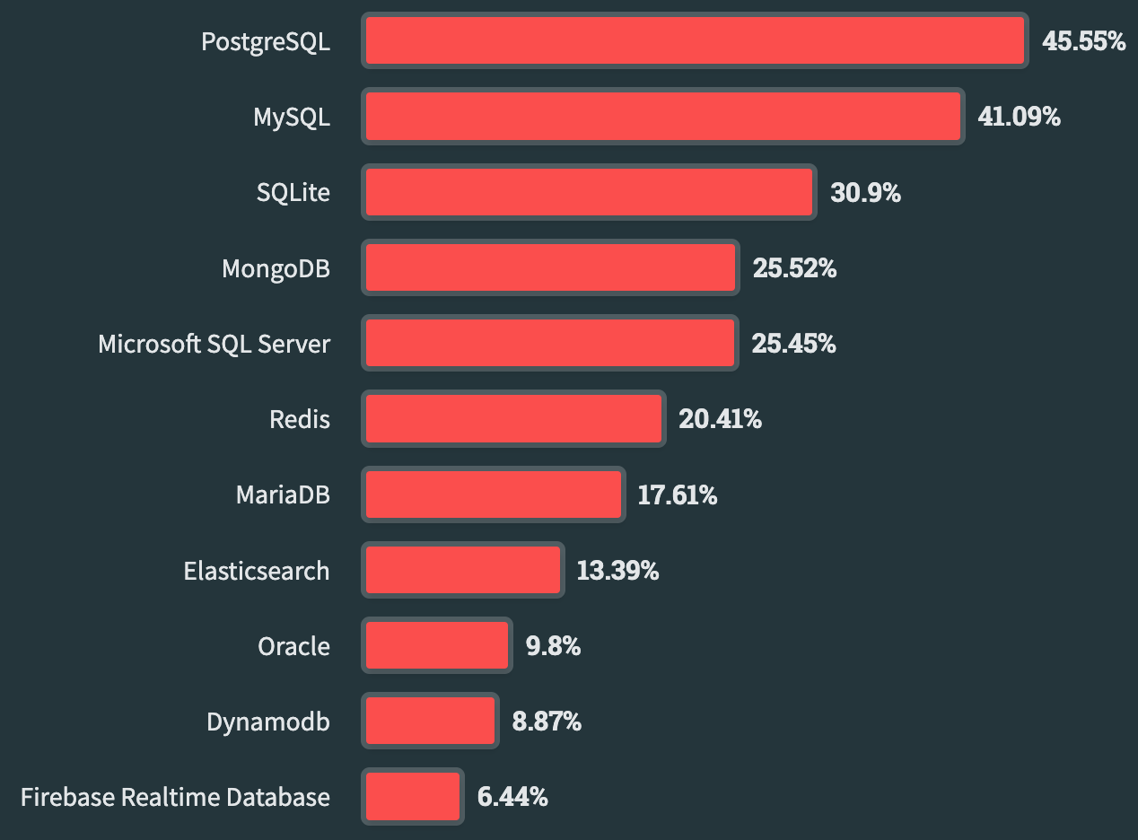
Popular Database Management Systems 2024
Stack Overflow Developer Survey, 2024

Slide 14
Information Structuring in Databases
Schema: structure and organization of the database
Attribute: relevant piece of information about the things of interest
Relationship: connection between things of interest
Examples:
Customer Database:
Attributes: Name, address, phone, account balance, credit rating, credit card number.
Relationships: Purchase and payment details.
Student Database:
Attributes: Name, address, phone, total/completed hours, GPA, standing.
Relationships: Courses, grades, library records, campus credit balance.

Slide 15
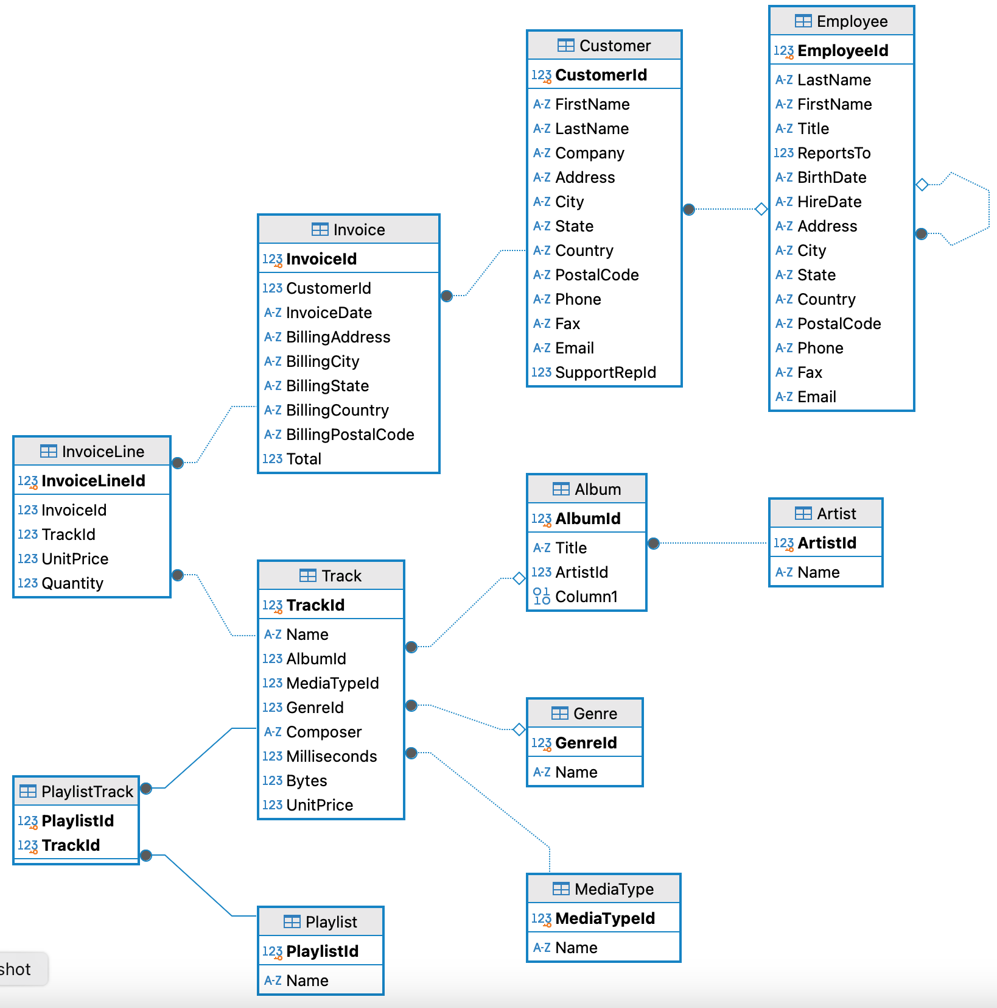
Database Schema
The following is Entity-Relationship Diagram (ERD) and is used to summarize database schemas that create Data Models.
This example represents a music store with key entities:
Customer,
Invoice,
InvoiceLine,
Track,
Album,
Artist,
Etc.

Slide 16
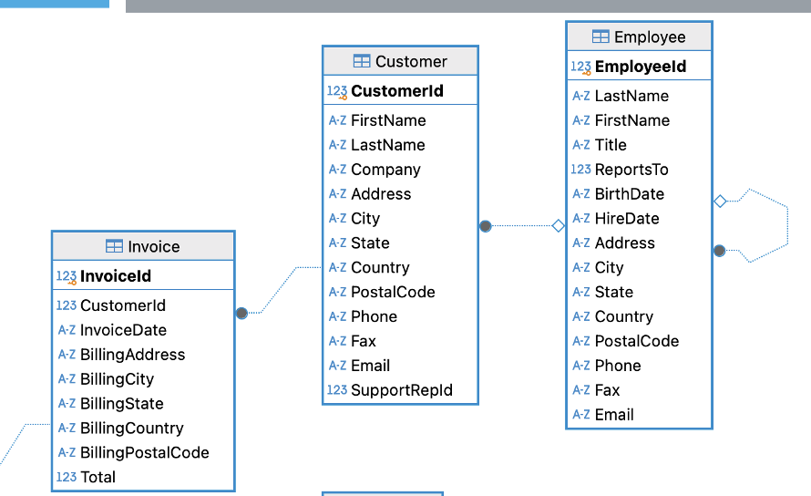
Primary Keys
Database rows (see Invoice Table to the right)
Contain information about instance Invoice (CustomerID, InvoiceDate, BillingAddress, etc.)
Each Invoice is represented by exactly 1 row
Primary Key: the key chosen as the attribute to uniquely define a row
Rows have identifiers to ensure that:
Data for each Invoice exists on only 1 row of the relation
Each row contains only data for 1 Invoice
InvoiceID fills this role, thus each value of InvoiceID must be unique

Slide 17
Foreign Keys
Notice that CustomerID exists in more than 1 one relation
Foreign keys:
A primary key attribute from one relation that exists in another relation (can also be the same relation)
Used to define connections (relationships) between two entities (tables)
Primary Keys
Foreign Key

Slide 18
High-level Database Application Architecture

Slide 19
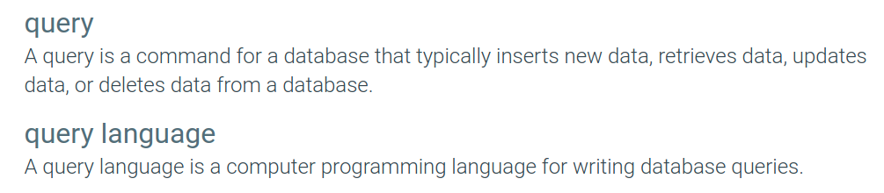
What is a Query?
CRUD operations: Create, Read, Update, and Delete data.

Slide 20
SQL – Structured Query Language
Non-procedural language
Find the name of the customer with customer-id 192-83-7465 select customer.customer-name from customer where customer.customer-id = ‘192-83-7465’
Find the balances of all accounts held by the customer with customer-id 192-83-7465 select account.balance from depositor, account where depositor.customer-id = ‘192-83-7465’ and depositor.account-number = account.account-number
Application programs generally access databases through ether:
Language extensions to allow embedded SQL (we will show how to do this with python)
Application program interface (e.g. ODBC/JDBC) which allow SQL queries to be sent to a database
Notes:
A non-procedural language, also known as a declarative language, is a type of programming language in which the programmer specifies what the program should accomplish rather than explicitly defining how to accomplish it. These languages focus on what needs to be done, leaving the underlying execution details to the compiler or interpreter.
SQL (Structured Query Language): You describe the data to be retrieved or manipulated without specifying the exact algorithm or steps to retrieve it.

Slide 21


Select
Key Components:
1. SELECT: This keyword is followed by the column names (or * for all columns) you want to retrieve.
2. FROM: Specifies the table from which to retrieve the data.
3. WHERE (optional): Adds a condition to filter the rows based on specific criteria.
4. ORDER BY, GROUP BY, HAVING (optional): Additional clauses to organize, group, or filter aggregated data.
The SELECT statement is the most commonly used SQL command for retrieving data. It allows users to specify columns, source tables, and conditions for filtering results. The basic syntax is:
This query retrieves the first and last names of customers from the “Customer” table where the customers are in the USA.

Slide 22
DISTINCT
The SQL DISTINCT clause is used to remove duplicate values from a result set.
When DISTINCT is applied to a column in a SELECT statement, it ensures that only unique values for that column are returned, eliminating any duplicates.
Syntax:
Retrieve unique invoice dates:
This query fetches all the unique dates on which invoices were issued from the Invoice table. If multiple invoices were issued on the same day, the date will appear only once in the result set.
SELECT DISTINCT InvoiceDate
FROM Invoice;
SELECT DISTINCT column1, column2, ...
FROM table_name;
When to Use DISTINCT:
• To eliminate duplicates from your result set when you’re only interested in unique values.
• On columns with repeating values, where you want to count or list only unique occurrences.
Get a list of unique customer first names:
SELECT DISTINCT FirstName
FROM Customer;

Slide 23


Where
The WHERE clause filters records in a query, retrieving only rows that meet specific conditions. It is applied after FROM and before optional clauses like GROUP BY or ORDER BY.
Key Points:
The condition in the WHERE clause filters data based on column values.
It supports logical operators like AND, OR, and NOT for combining multiple conditions.
It can work with comparison operators (=, !=, >, <, etc.), pattern matching (LIKE), ranges (BETWEEN), lists (IN), and more.
This query selects all customers from the “Customers” table where the country is “USA”, and their age is greater than 30.

Slide 24
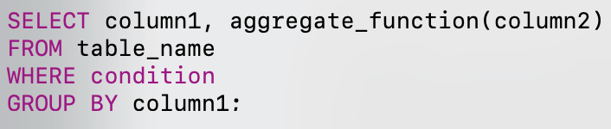
Group by
The GROUP BY clause groups rows with the same values into summary rows, often used with aggregate functions like COUNT(), SUM(), AVG(), MIN(), or MAX() to produce summarized results.
GROUP BY groups the rows based on the unique values of one or more columns.
It is typically used alongside aggregate functions to perform calculations on each group, such as counting occurrences or summing values.
Every column in the SELECT statement that is not an aggregate function must be included in the GROUP BY clause.
It can be followed by the HAVING clause to filter groups (similar to how WHERE filters rows).
SELECT BillingCountry, COUNT(*)
FROM Invoice
GROUP BY BillingCountry;

Slide 25
Group BY Illustrated
Grouping
Selection
USA
USA
USA
USA
BillingCountry
USA
GER
CAN
CAN
GER
USA
USA
CAN
USA
Aggregation
SELECT BillingCountry, COUNT(*)
FROM Invoice
GROUP BY BillingCountry;
BillingCountry | COUNT(*)
USA | 4
CAN | 3
GER | 2
CAN
CAN
CAN
GER
GER

Slide 26
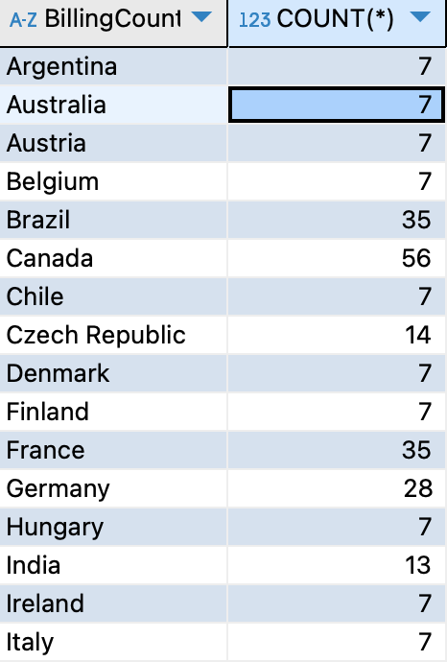
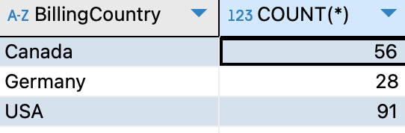
Group BY Results
SELECT BillingCountry, COUNT(*)
FROM Invoice
GROUP BY BillingCountry;
SELECT BillingCountry, COUNT(*)
FROM Invoice
WHERE BillingCountry IN ("USA", "Canada","Germany")
GROUP BY BillingCountry;

Slide 27
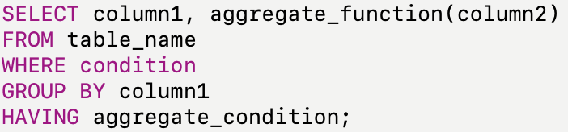
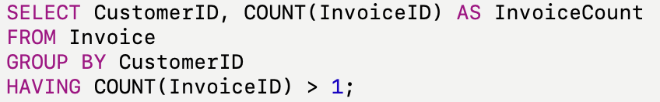
Having
The HAVING clause in SQL is used to filter the results of a GROUP BY query.
It is similar to the WHERE clause, but the key difference is that HAVING operates on aggregated data after the GROUP BY operation, whereas WHERE filters rows before aggregation.
• GROUP BY: Groups the invoices by CustomerID.
• COUNT(InvoiceID): Counts the number of invoices for each customer.
• HAVING COUNT(InvoiceID) > 1: Filters only those customers who have more than one invoice.

Slide 28
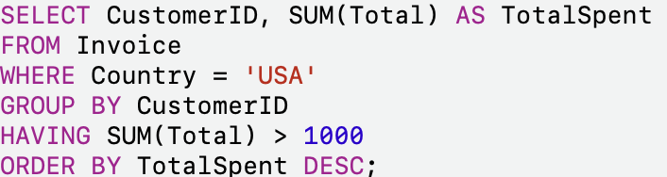
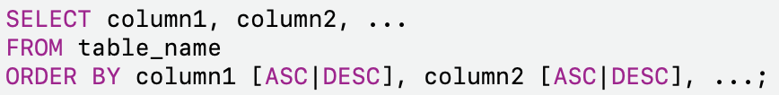
ORDER BY
We want to retrieve the CustomerID and Total spent for all customers in the USA who have spent more than $1000 on invoices, and we’ll group the data by customer and order by total spent.
The ORDER BY clause in SQL is used to sort the results of a query by one or more columns.
You can specify whether the sorting should be in ascending (ASC) or descending (DESC) order.
By default, the ORDER BY clause sorts in ascending order if not explicitly stated.
ORDER BY is typically the last clause in a SQL query, after SELECT, FROM, WHERE, GROUP BY, and HAVING.
Using ORDER BY can have performance implications, especially on large datasets, as the database needs to sort all the data before returning it.
1. SELECT: Retrieves the CustomerID and the total amount spent (SUM(Total)) for each customer.
2. FROM: Specifies the Invoice table where the data is stored.
3. WHERE: Filters for customers whose Country is the USA.
4. GROUP BY: Groups the results by CustomerID, so we can sum the Total for each customer.
5. HAVING: Filters the grouped data to include only customers whose total spending exceeds $1000.
6. ORDER BY: Orders the results by TotalSpent in descending order, so the highest spenders appear first.

Slide 29
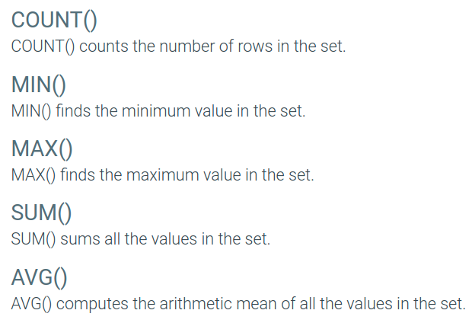
Common Aggregation Functions
--Find the total number of invoices in the Invoice table
SELECT COUNT(*) FROM Invoice;
--Calculate the total value of all invoices:
SELECT SUM(Total) FROM Invoice;
--Find the average total of invoices
SELECT AVG(Total) FROM Invoice;
--Find the maximum invoice total
SELECT MAX(Total) AS MaxInvoiceTotal FROM Invoice;
--Find the minimum invoice total
SELECT MIN(Total) AS MinInvoiceTotal FROM Invoice;

Slide 30
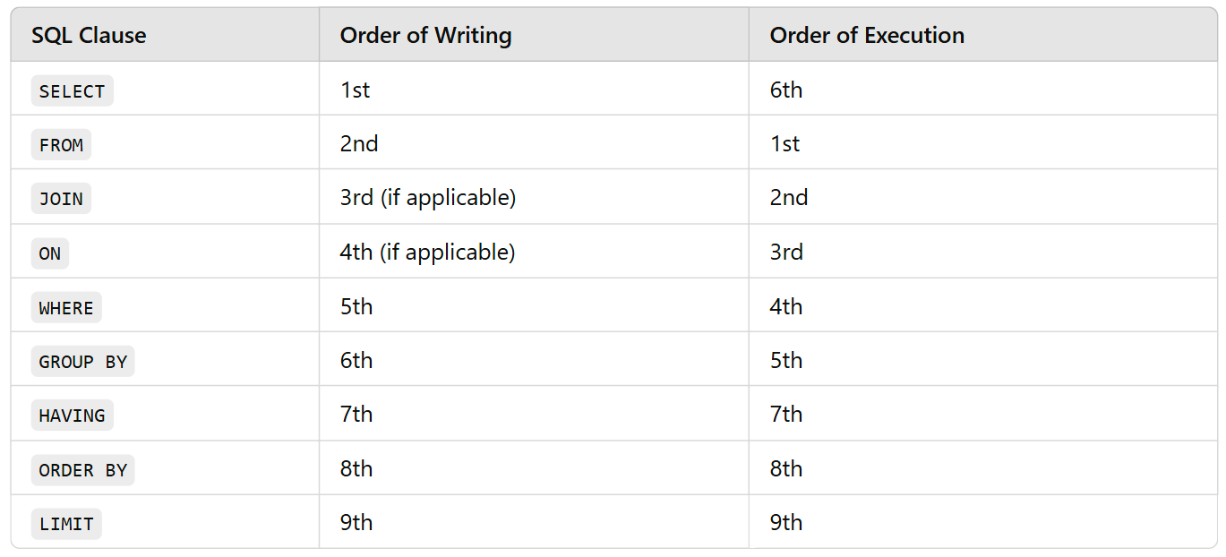
Query order or writing and execution

Slide 31
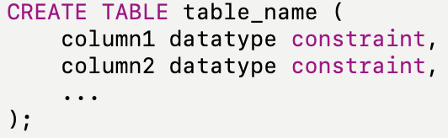
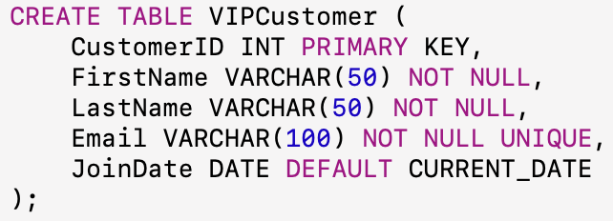
Create Table <Table Name>
The CREATE TABLE statement in SQL is used to define a new table in a database.
It specifies the table name, column names, their data types, constraints (e.g., primary key, foreign key), and any default values.
Key Elements:
Table Name: The name of the table being created.
Column Definitions: The list of columns, each with a name, data type (such as INT, VARCHAR, DATE, etc.), and optional constraints (like PRIMARY KEY, NOT NULL, UNIQUE).
Constraints: Define rules for the data in the table, such as:
PRIMARY KEY: Uniquely identifies each record in the table.
FOREIGN KEY: Links this table to another table.
NOT NULL: Ensures a column cannot have a null value.
DEFAULT: Provides a default value for a column.
Notes:
Explanation:
1. CustomerID: This is an integer (INT) and acts as the PRIMARY KEY, which means it uniquely identifies each record and cannot be null.
2. FirstName and LastName: These are character strings with a maximum length of 50 (VARCHAR(50)). Both are marked as NOT NULL, meaning the customer must have a first and last name.
3. Email: A string of up to 100 characters (VARCHAR(100)), marked as NOT NULL and UNIQUE, ensuring no two customers can have the same email address.
4. JoinDate: This is a DATE field, with a default value of the current date (CURRENT_DATE), so if no date is provided, it defaults to today’s date.
Adding Constraints:
• PRIMARY KEY: Ensures each CustomerID is unique.
• NOT NULL: Ensures values are provided for required fields.
• UNIQUE: Ensures email addresses are not duplicated.
• DEFAULT: Automatically assigns a value (like the current date for JoinDate) if none is provided during insertion.

Slide 32
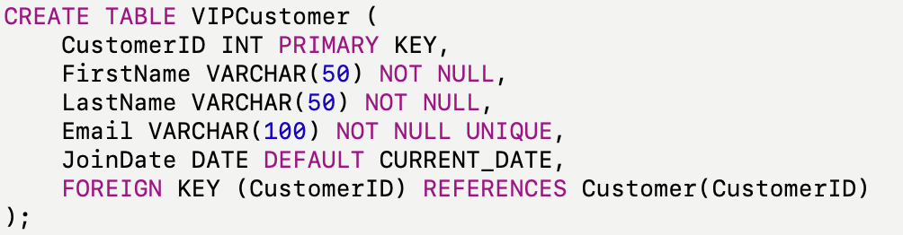
Create Table <Table Name> (With Foreign Key)
If you wanted the VIPCustomer table to reference another table (for example, linking the CustomerID to a Customer table), you could add a foreign key.
We have two tables: VIPCustomer (that we created) and an existing table called Customer.
We could have made it less confusing if we’d named the two IDs differently. ☺
In this case, the CustomerID column in the VIPCustomer table references the CustomerID column in the Customer table, establishing a link between the two tables.
Notes:
Explanation:
1. CustomerID: This is an integer (INT) and acts as the PRIMARY KEY, which means it uniquely identifies each record and cannot be null.
2. FirstName and LastName: These are character strings with a maximum length of 50 (VARCHAR(50)). Both are marked as NOT NULL, meaning the customer must have a first and last name.
3. Email: A string of up to 100 characters (VARCHAR(100)), marked as NOT NULL and UNIQUE, ensuring no two customers can have the same email address.
4. JoinDate: This is a DATE field, with a default value of the current date (CURRENT_DATE), so if no date is provided, it defaults to today’s date.
Adding Constraints:
• PRIMARY KEY: Ensures each CustomerID is unique.
• NOT NULL: Ensures values are provided for required fields.
• UNIQUE: Ensures email addresses are not duplicated.
• DEFAULT: Automatically assigns a value (like the current date for JoinDate) if none is provided during insertion.

Slide 33


Insert into <Table>
Example 1: Insert data into all columns:
In this example, values are provided for all columns in the VIPCustomer table. Make sure that the values match the data types specified for each column.
To insert data into the VIPCustomer table, you use the SQL INSERT INTO statement. The syntax depends on whether you’re inserting values for all columns or just a subset of them
Example 2: Insert data into specific columns:
Here, only the CustomerID, FirstName, and Email are provided, so other columns will either take their default values or remain NULL if allowed

Slide 34


Update <table>
Example 1: Update a single column
To update existing records in a table, you use the SQL UPDATE statement along with the SET clause to specify which columns to modify
The WHERE clause is critical in the UPDATE statement to target specific rows. If you omit it, all rows in the table will be updated.
Always ensure that the values being inserted or updated conform to the data types and constraints defined in the table (e.g., not null, unique, etc.).
This updates the email of the customer with CustomerID = 1.
Example 2: Update multiple columns:
Here, both the LastName and Email are updated for the customer with CustomerID = 2.

Slide 35
DROP TABLE <Table Name>
DROP TABLE: Completely deletes the table from the database.
This action cannot be undone, so use it carefully.
Any foreign key constraints that reference the table will also be affected, and depending on your database’s configuration, you may need to drop those constraints first.
To delete the VIPCustomer table from the database, you would use the SQL DROP TABLE statement. This command removes the entire table, including all of its data, structure, and relationships.
DROP TABLE VIPCustomer;
If you want to keep the table structure but remove all the data, you would use the TRUNCATE statement instead:
TRUNCATE TABLE VIPCustomer;

